Slide 1
Statistics for IT
Lecture 5,6: Measures in Statistics

Slide 2
Course Objectives
After completing this module, students should be able to
Summarize data, using measures of central tendency, such as the mean, median, mode, and midrange.
Describe data, using measures of variation, such as the range, variance, and standard deviation.
Identify the position of a data value in a data set, using various measures of position, such as percentiles, deciles, and quartiles.

Slide 3
Measures in Statistics
Measures in Statistics
Measures in Central Tendency (Measures of Location)
Measures in Dispersion
Ungrouped Data
Grouped Data
Mean
Median
Mode
Weighted Mean
Mean
Median
Mode
Range
Inter Quartile Range
Standard Deviation
Variance

Slide 4
Measures in Central Tendency (Measures of Location)
A measure of central tendency is a descriptive statistic that describes the average, or typical value of a set of scores
There are three common measures of central tendency:
the mean
the median
the mode

Slide 5
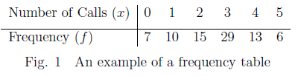
Frequency Tables
When raw data is organized it can be helpful to display it in the form of a table showing the frequency (f) with which each data item (x) occurs. Such a table is called a frequency table.
Eg.

Slide 6
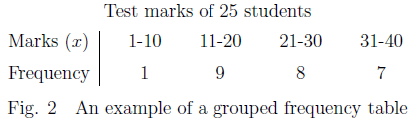
Grouped frequency table
However, when a larger range of data is involved it may be beneficial to first break the data down into small groups, in which case, the resulting table is referred to as a grouped frequency table.

Slide 7
Mean (Arithmetic Mean)
The mean is the average of the numbers: a calculated "central" value of a set of numbers. To calculate it: add up all the numbers, then divide by how many numbers there are…….

Slide 8
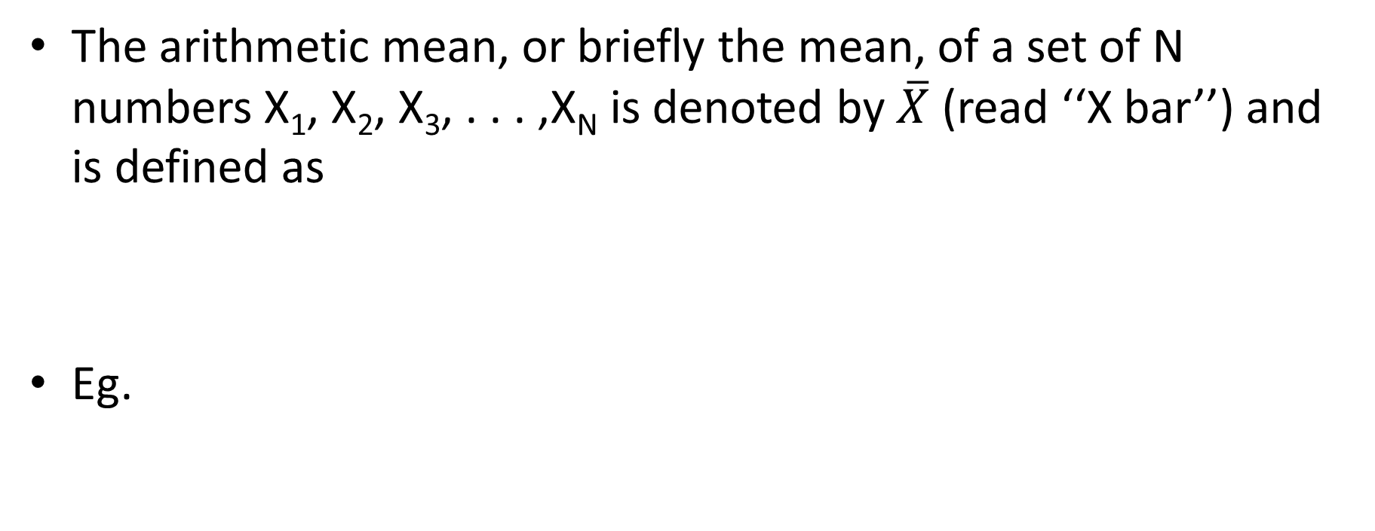
Arithmetic Mean-ungrouped
The arithmetic mean, or briefly the mean, of a set of N numbers X₁, X₂, X₃, . . . ,X_{N} is denoted by $\overline{X}$ (read ‘‘X bar’’) and is defined as
Eg.

Slide 9
Arithmetic Mean Ungrouped …
If the numbers X₁, X₂, . . . , X_{K} occur f₁, f₂, . . . , f_{K} times, respectively (i.e., occur with frequencies f₁, f₂, . . . , f_{K}), the arithmetic mean is
Eg.

Slide 10
Arithmetic Mean…

Slide 11
Weighted mean

Slide 12
THE ARITHMETIC MEAN COMPUTED FROM GROUPED DATA
The procedure for finding the mean for grouped data assumes that the mean of all the raw data values in each class is equal to the midpoint of the class. In reality, this is not true, since the average of the raw data values in each class usually will not be exactly equal to the midpoint. However, using this procedure will give an acceptable approximation of the mean, since some values fall above the midpoint and other values fall below the midpoint for each class, and the midpoint represents an estimate of all values in the class.

Slide 14
Worked Example
Miles Run per Week
Using the given frequency distribution, find the mean. The data represent the number of miles run during one week for a sample of 20 runners.

Slide 17
The Median
The median is the halfway point in a data set. Before you can find this point, the data must be arranged in order. When the data set is ordered, it is called a data array. The median either will be a specific value in the data set or will fall between two values.

Slide 18
Worked Example
The number of rooms in the seven hotels in the town X is 713, 300, 618, 595, 311, 401, and 292. Find the median.

Slide 19
Worked example
The number of tornadoes that have occurred in the United States over an 8-year period follows. Find the median.
684, 764, 656, 702, 856, 1133, 1132, 1303

Slide 20
Median - Grouped data
The median of a sample of data organized in a frequency distribution is computed by the following formula:
where
L- is the lower limit of the median class,
CF- is the cumulative frequency preceding the median class,
f - is the frequency of the median class, and
i - is the median class interval.

Slide 21
Finding the Median Class
To determine the median class for grouped data:
Construct a cumulative frequency distribution.
Divide the total number of data values by 2.
Determine which class will contain this value. For example, if n=50, 50/2 = 25, then determine which class will contain the 25th value - the median class.

Slide 22
The Mode
The mode is the value that occurs most often in the data set.
Unimodal
A data set that has only one value that occurs with the greatest frequency is said to be unimodal.
Bimodal
If a data set has two values that occur with the same greatest frequency, both values are considered to be the mode and the data set is said to be bimodal.
Multimodal
If a data set has more than two values that occur with the same greatest frequency, each value is used as the mode, and the data set is said to be multimodal.
No mode
When no data value occurs more than once, the data set is said to have no mode.

Slide 23
Worked Example
Find the mode of the signing bonuses of eight NFL players for a specific year.
The bonuses in millions of Ruppes are 18.0, 14.0, 34.5, 10, 11.3, 10, 12.4, 10
Answer
10, 10, 10, 11.3, 12.4, 14.0, 18.0, 34.5
Since Rs. 10 million occurred 3 times—a frequency larger than any other number—the mode is Rs.10 million.

Slide 25
Mode - Grouped data
The mode for grouped data is approximated by the midpoint of the class with the largest class frequency.
The class with the largest frequency is called modal class.
Following formula estimates the mode of grouped data
Where
L_{mo} is the lower boundary of the modal class
Da is the difference between the frequency of the modal class and the class preceding it
Db difference between the frequency of the modal class and the class after it
C is the class interval of the modal class

Slide 26
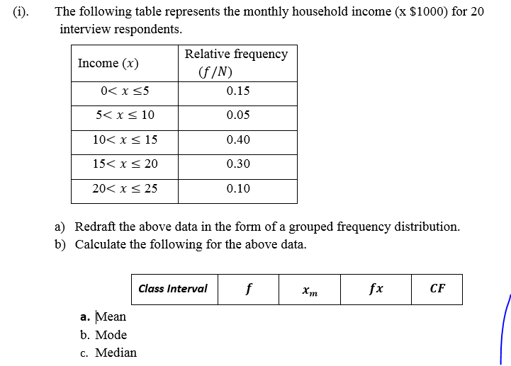

Slide 27
Thank You!

